Slide 1

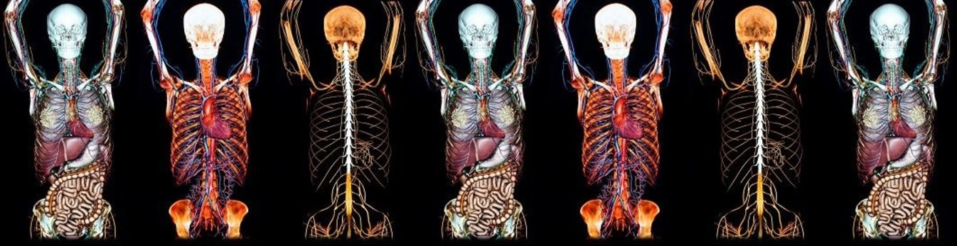
Alethea Kelsey & Victoria McCulloch

Slide 2
What’s New in Anatomy?

Slide 3

What’s New in Anatomy?
Postgraduate Distance Learning Programme
Science Saturday, National Museum of Scotland
Public Workshops
Anatomy in Art Exhibition

Slide 4
What’s New in Anatomy?
Postgraduate Distance Learning Programme
Science Saturday, National Museum of Scotland
Public Workshops
Anatomy in Art Exhibition

Slide 5
What’s New in Anatomy?
Postgraduate Certificate Anatomical Sciences (Online)
  Started September 2015
  ~15 students
  Courses include Fundamentals of Anatomy 1 & 2,
  Embryology, Neuroanatomy
  Three terms
  From September to July

Slide 6
What’s New in Anatomy?
Postgraduate Certificate Anatomical Sciences (Online)
  Started September 2015
  ~15 students
  Courses include Fundamentals of Anatomy,
  Embryology, Neuroanatomy
Postgraduate Diploma Anatomical Sciences (Online)
  From September 2016
  Courses include Advanced Anatomy, Histology,
  Anatomy & Medical Imaging

Slide 7
What’s New in Anatomy?
Postgraduate Distance Learning Programme
  Video lectures
  Interactive, downloadable workbooks
  Short formative tests
  Variety of summative assessment methods

Slide 8
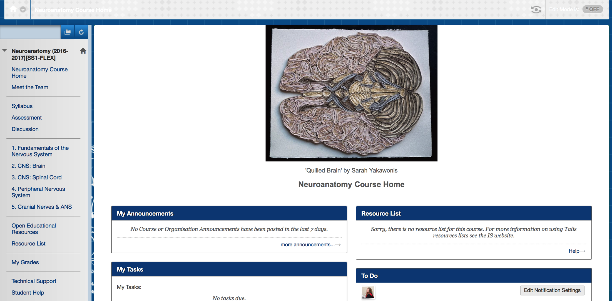
Virtual Learning Environment

Slide 9
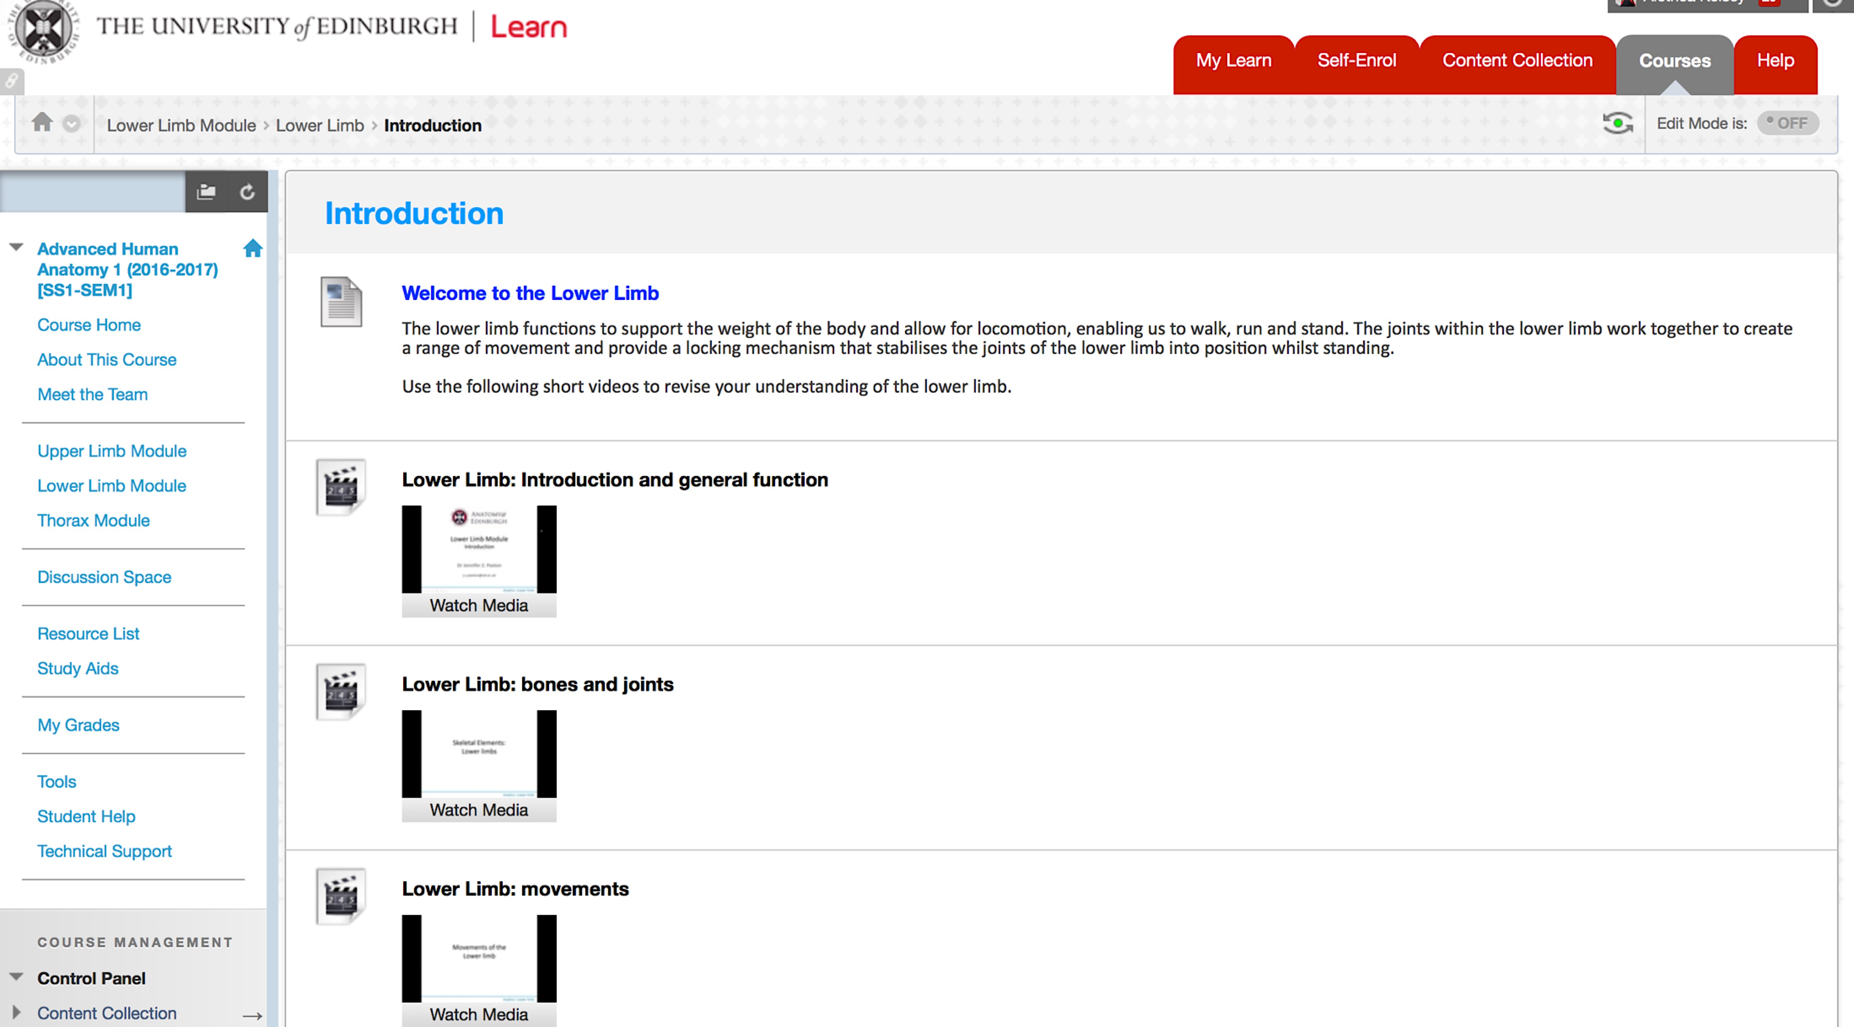
Notes:
Virtual Learning Environment

Slide 10
What’s New in Anatomy?
“I really like the video lectures”
“I’m really enjoying the content of the course. I found the WIKI subject interesting”
“The discussion board is a fast way of communicating with tutors and fellow students”
“Content of the learning material and ‘Casefiles’ – really enjoyed having to research about medical problems/diseases to answer Casefiles”
“I found the material engaging and I love the application of anatomy in this course. I really enjoyed looking at whole systems”

Slide 11
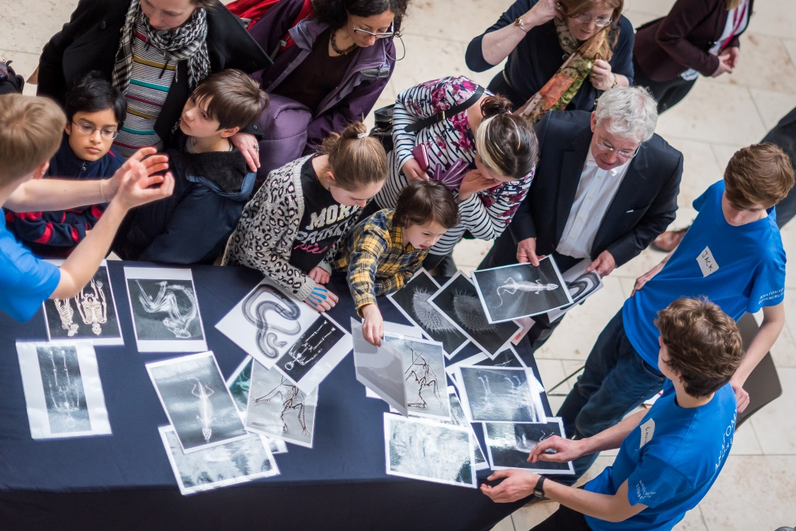
What’s New in Anatomy?
Science Saturday, National Museum of Scotland
  18th February 2017
  ~100 student volunteers
  Public learning

Slide 12
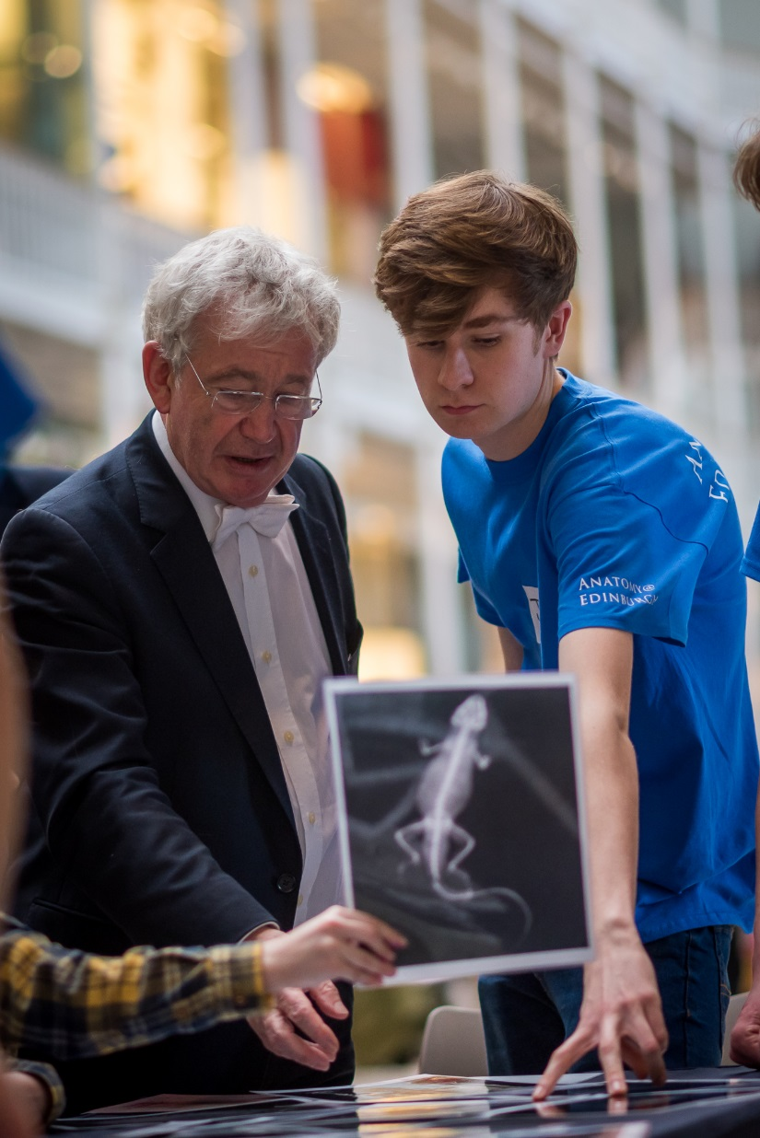
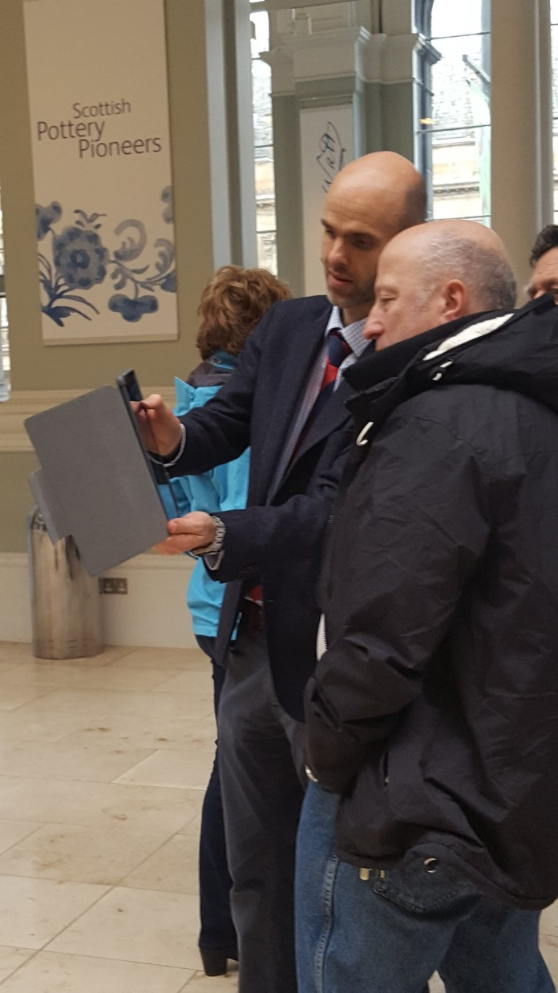
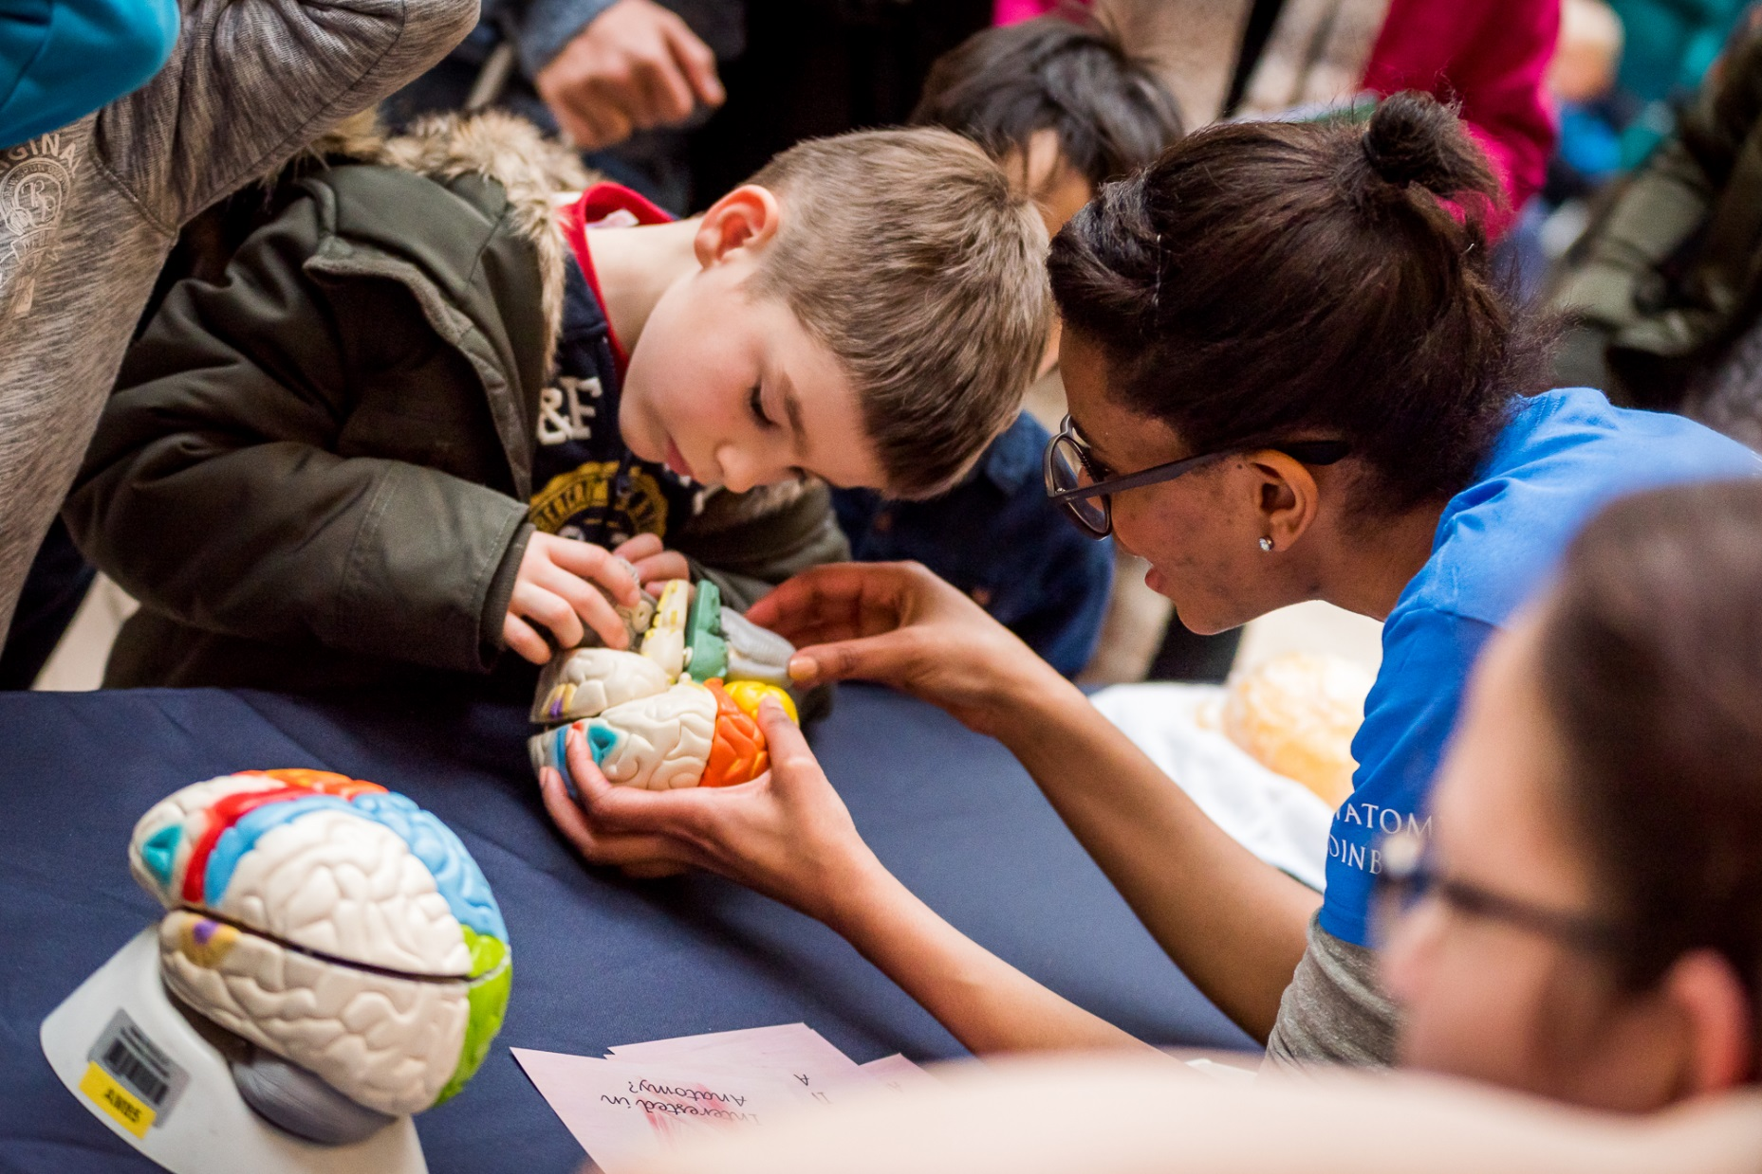
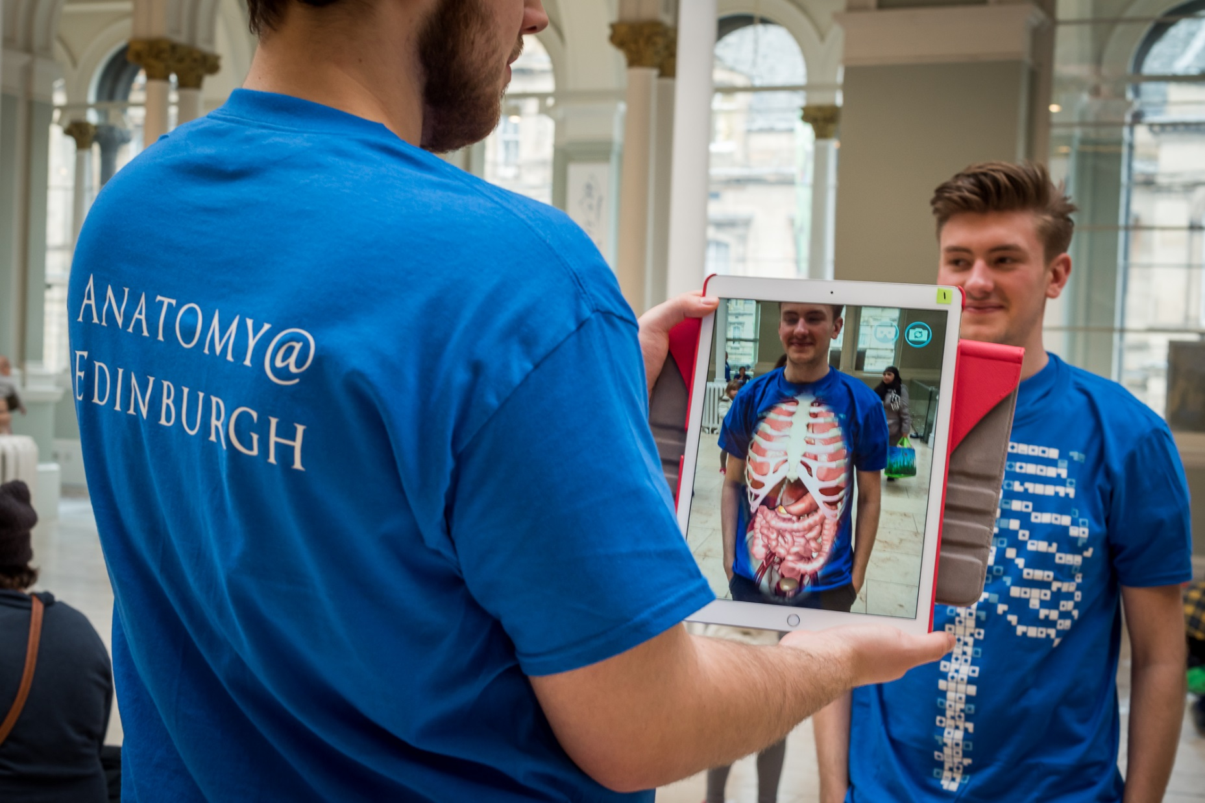

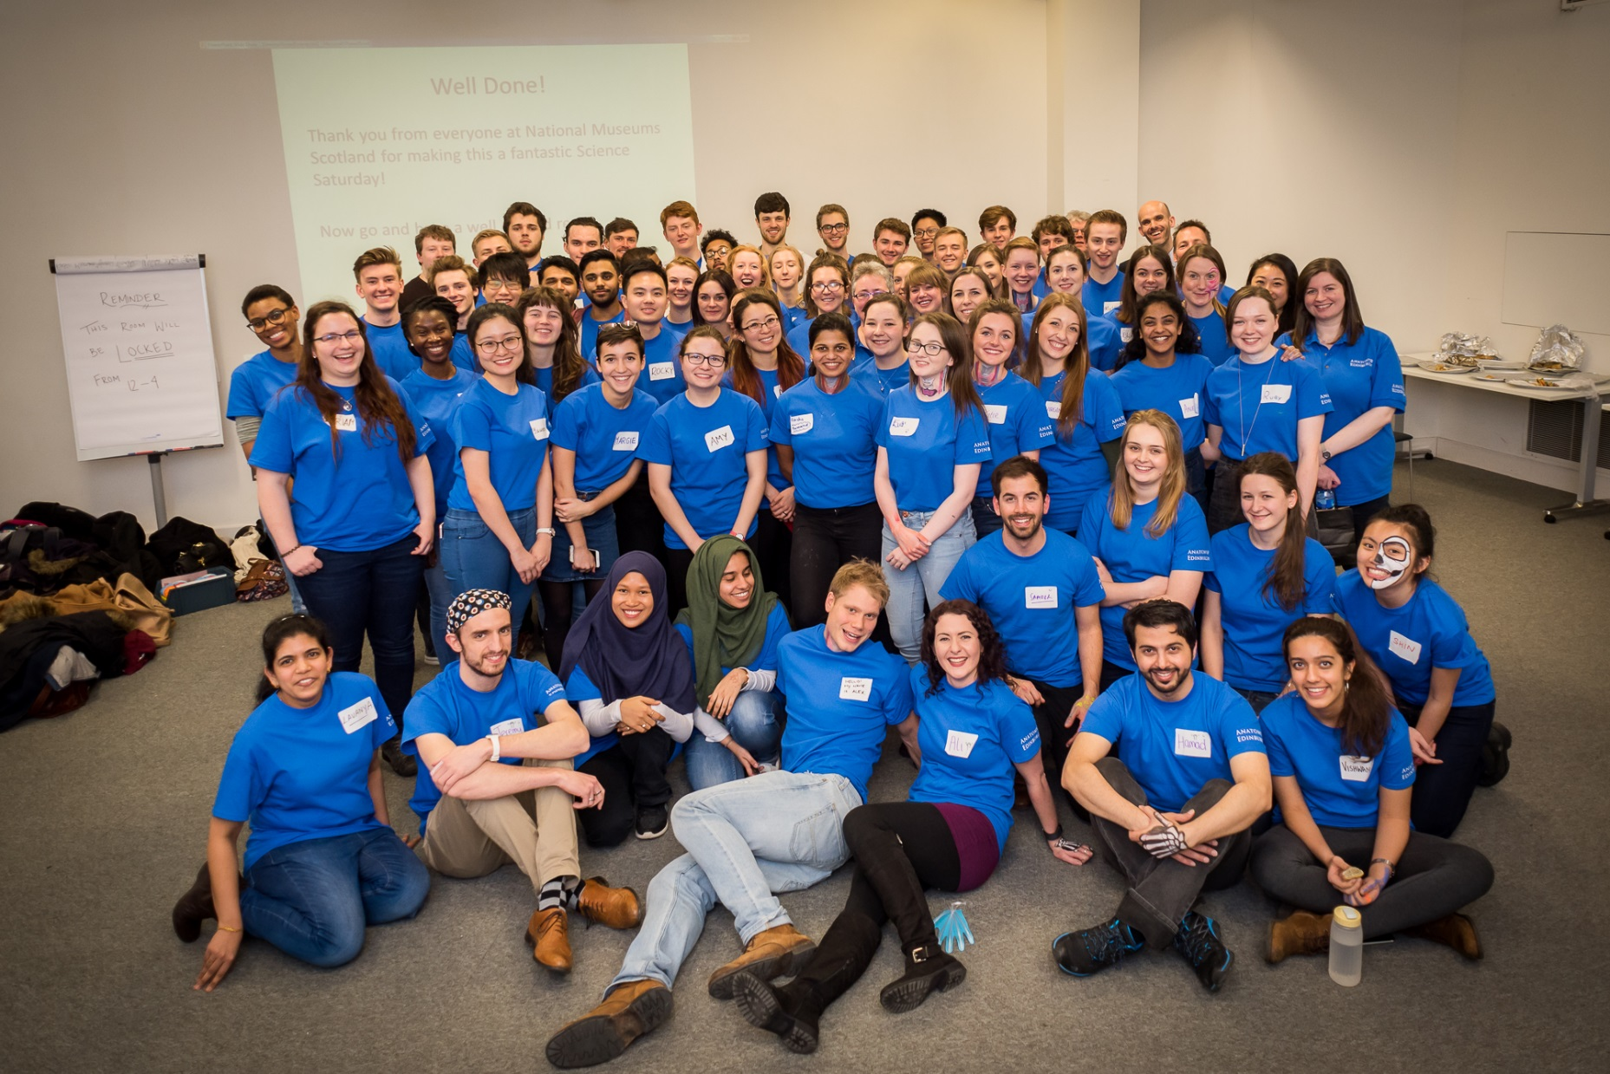


Slide 13
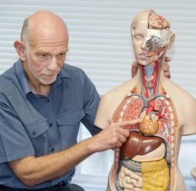
What’s New in Anatomy?
Public Workshops
  Public learning
  Series of lectures/ practical class
    Upper limb
    Lower limb
    Nervous system
    Chest
    Abdomen & pelvis
    Head & neck
  3rd year running
  Anatomical Museum

Slide 14
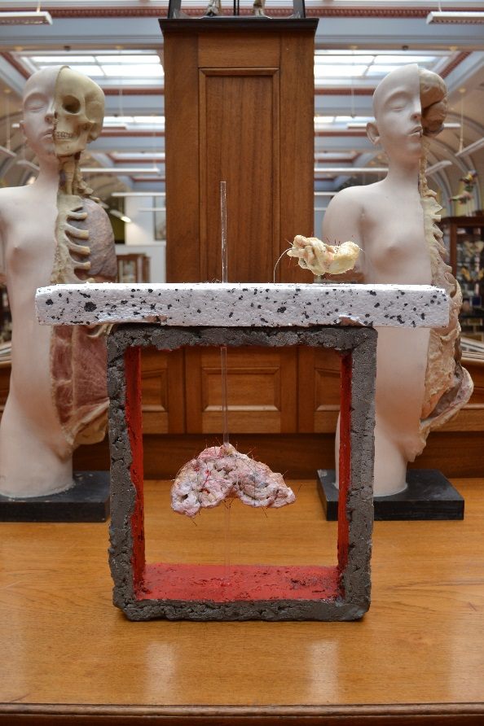
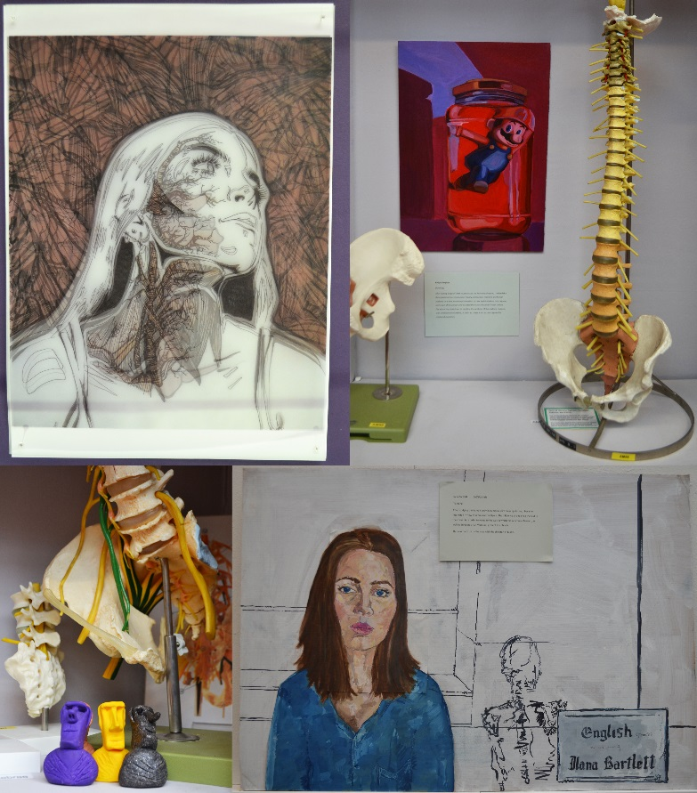
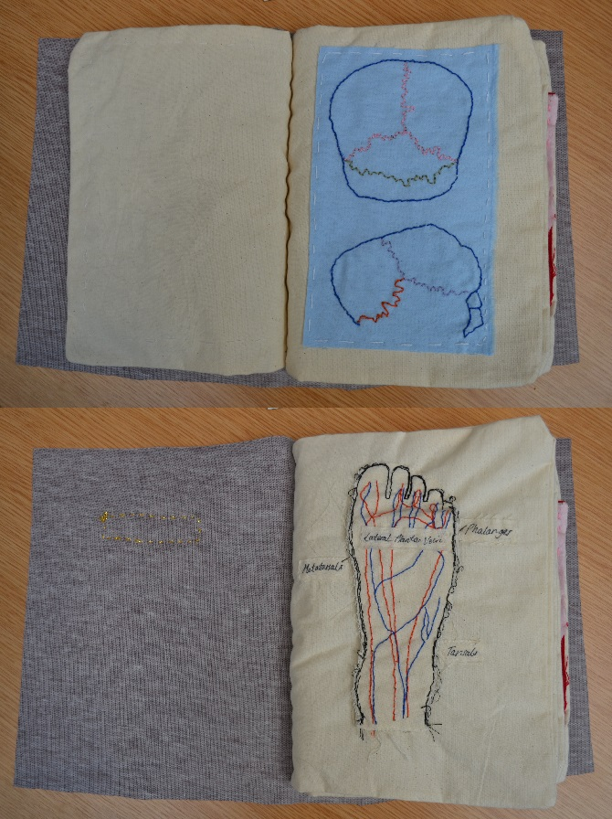
What’s New in Anatomy?
Anatomy in Art Exhibition
  Collaboration between Anatomy@Edinburgh & Edinburgh College of Art
  Saturday 29th April 2017, Anatomical Museum

Slide 15
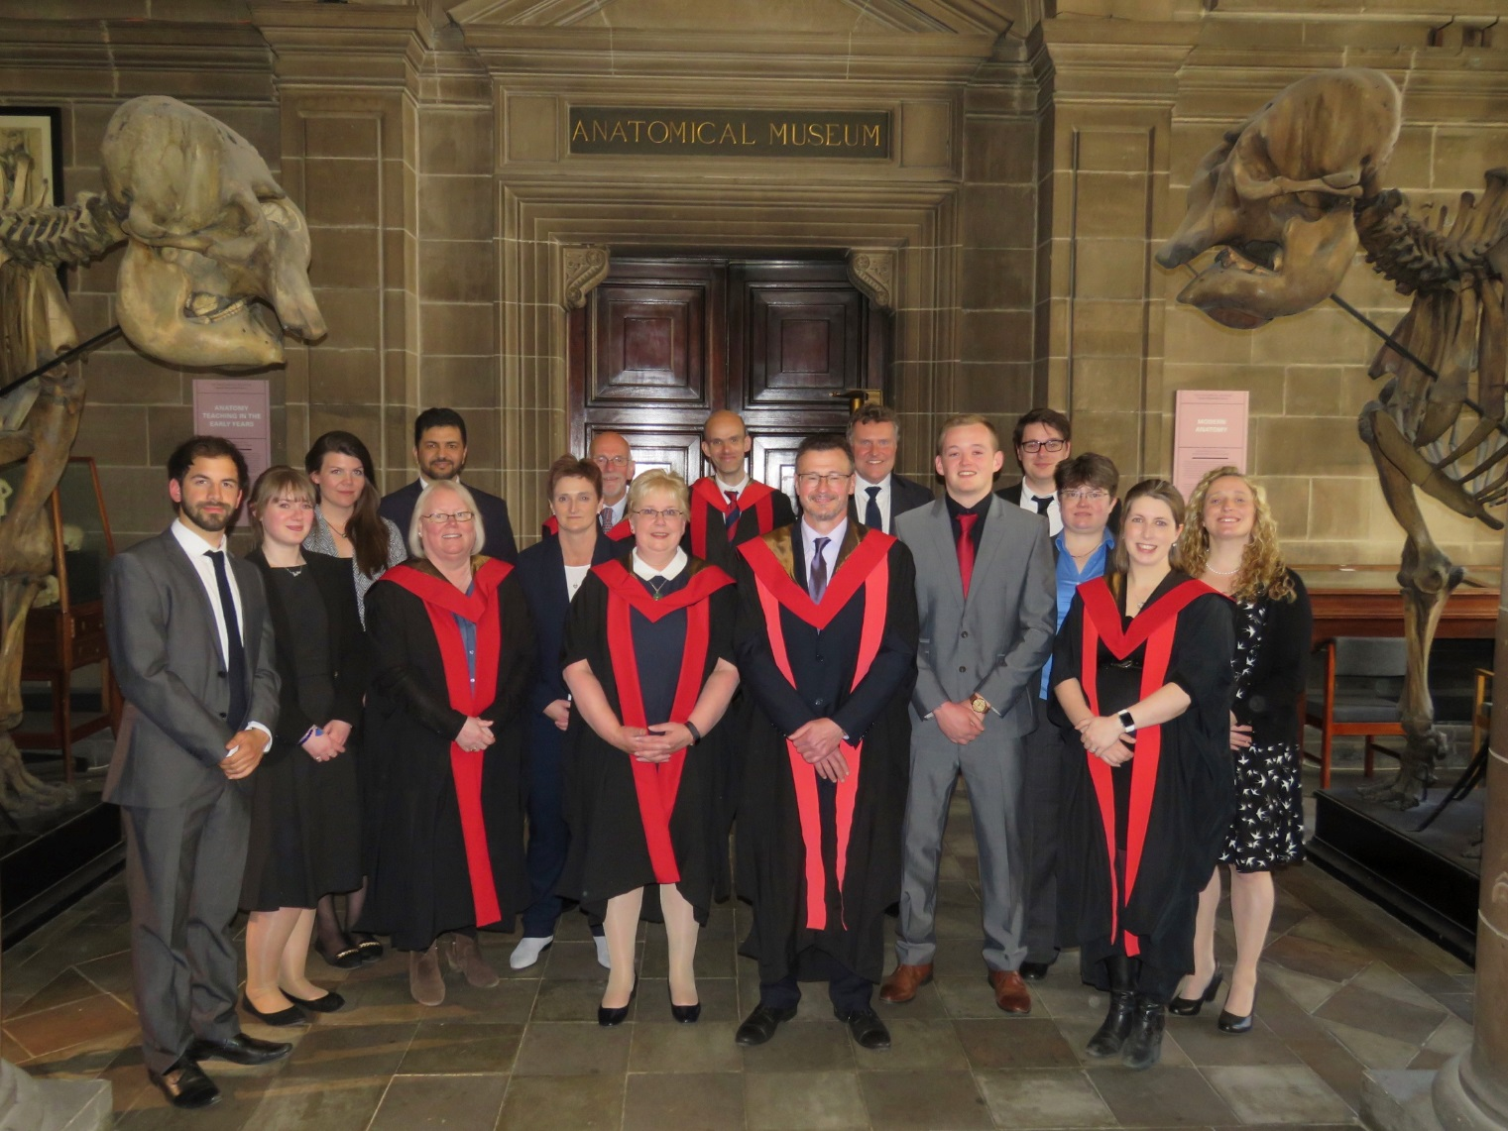
Thank You!
Twitter: @AnatomyatEd

